Slide 1
C# & .NET Framework
Chapter 25:
XML Web Services
Download : 12_WebService_New.pptx
( Web_Form )
Read from slide 1 to 12 and do Demo about WebService from slide 19 to 28

Slide 2
Summary
HTTP issue: Stateless
ASP.NET provides several mechanisms to maintain stateful information in your web applications:
Make use of ASP.NET view state.
Define application-level variables.
Make use of the cache object.
Define session-level variables.
Interact with cookie data.
Configuring web site through web.config

Slide 3
Chapter 25: Objectives
XML Web Services introduction
The .NET XML Web Service Namespaces
Building an XML Web Service by Hand
Building an XML Web Service Using Visual Studio 2005
The Role of the WebService Base Class
Understanding the [WebService] Attribute
Understanding the [WebServiceBinding] Attribute
Understanding the [WebMethod] Attribute
Exploring the Web Service Description Language (WSDL)
XML Web Service Wire Protocols
Generating Proxy Code Using Visual Studio 2005

Slide 4
XML Web Services Introduction
What is Web service?
Web services are typically application programming interfaces (API) or web APIs that are accessed via Hypertext Transfer Protocol(HTTP) and executed on a remote system
Benefits of XML Web Services
XML web services allow you to invoke methods and properties of a remote object using standard HTTP requests.
XML web services provide a way for unrelated platforms, operating systems, and programming languages to exchange information in harmony.

Slide 5
XML Web Services Introduction
XML Web Service Clients
XML web service client is not limited to a web page
The proxy’s implementation code forwards requests to the XML web service using standard HTTP.
The proxy also maps the incoming stream of XML back into .NET-specific data types (or whatever type system is required by the consumer application).

Slide 6
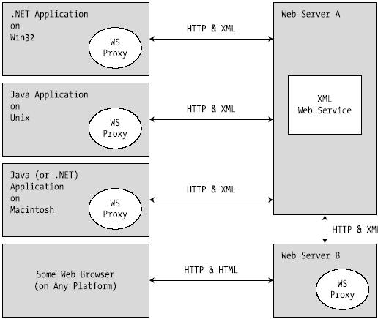
XML Web Services Introduction

Slide 7
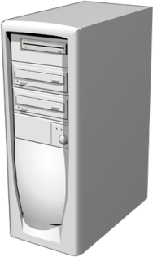




UDDI (Web Service Discovery /Broker)
SOAP
Publish
Find
SOAP
Internet
IIS
Bind
Web Service Provider
SOAP
Web Service Consumer

Slide 8
XML Web Services Introduction
XML Web Service Components
An XML web service involves the following core technologies:
A discovery service: helps clients resolve the location of the XML web service.
A description service: helps clients know what the XML web service can do.
A transport protocol: pass the information between the client and the XML web service.

Slide 9
XML Web Services Introduction
XML Web Service Discovery
In order to allow client to look up a web service, it must be registered with a Universal Description, Discovery, and Integration (UDDI) server.
Clients may submit request to a UDDI catalog to find a list of all web services that match some search criteria.
In addition to UDDI catalog, Client can use Discovery of Web Services (DISCO) to locate Web services.

Slide 10
XML Web Services Introduction
XML Web Service Description
The client must fully understand the exposed functionality before invoking methods.
A XML web service is described using Web Service Description Language (WSDL).
WSDL will be automatically generated by Microsoft IIS when the incoming request has a ?wsdl suffix.

Slide 11
XML Web Services Introduction
Transport Protocol.
HTTP GET, HTTP POST, or SOAP can be used to move information between consumers and web services.
SOAP messages can contain XML descriptions of complex types (including your custom types as well as types within the .NET base class libraries).
HTTP GET or HTTP POST protocols is restricted to a more limited set of core data XML schema types.

Slide 12
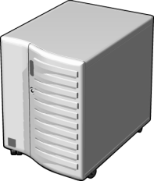
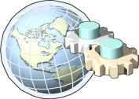


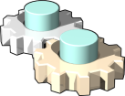
Web Service Components Interaction
5
1
Pricing Web Service
UDDI Services
3
4
2
1
Web service developer: builds and deploys a pricing Web service
2
Web service developer: registers and categorizes the Web service
3
Web service consumer: queries UDDI for “pricing” services
4
Web service consumer: determines the most appropriate “pricing” service
5
Web service developer: builds a solution that directly consumes the Web service data

Slide 13
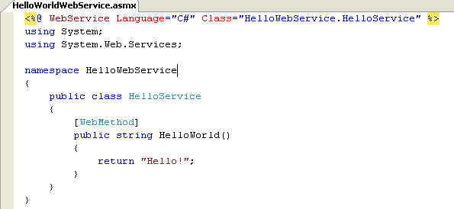
The first web service
HelloWorldWebService.asmx

Slide 14
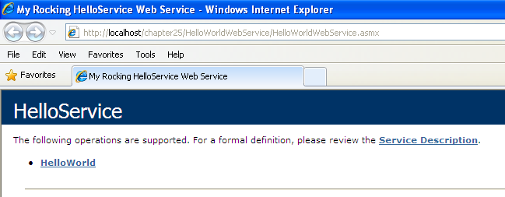
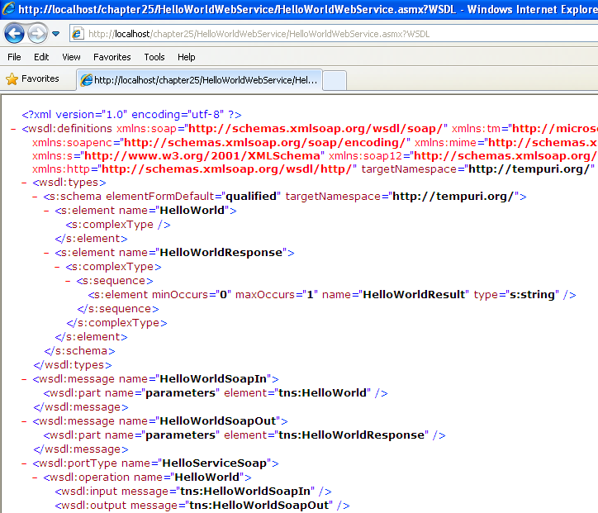

Slide 15
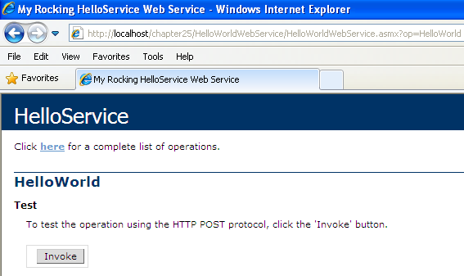
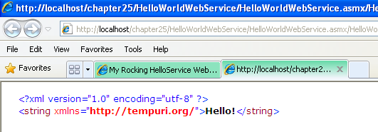

Slide 16
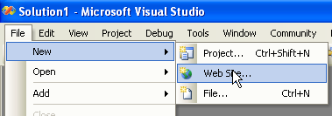
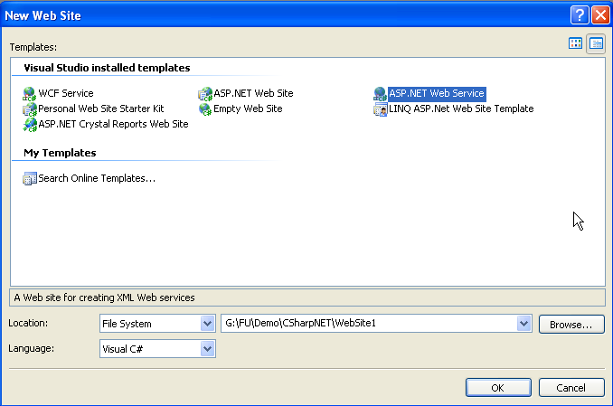
Building an XML Web Service Using VisualStudio 2005

Slide 17
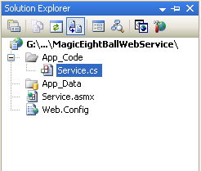
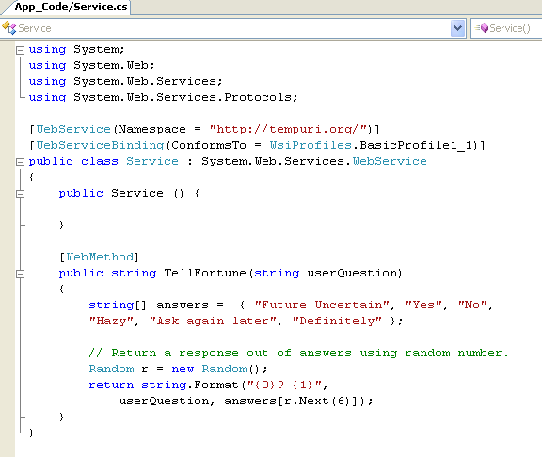
Ex: Ch_25 Code\MagicEightBallWebService

Slide 18
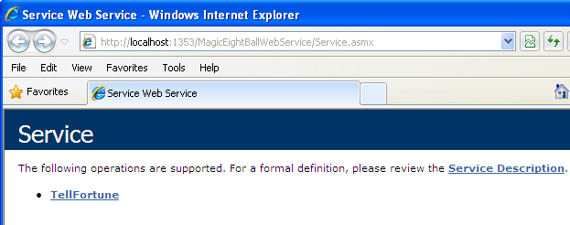
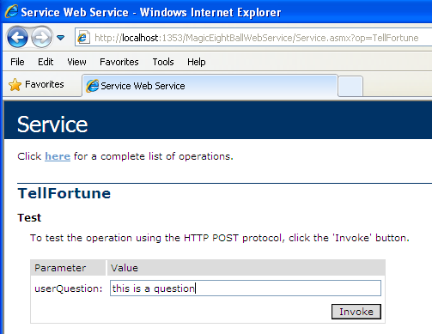
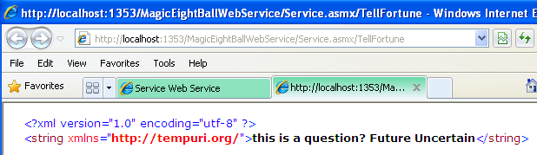

Slide 19
#1.Create WebService Application #2.Create Client Application From Step 01 to Step 06
Demo

Slide 20
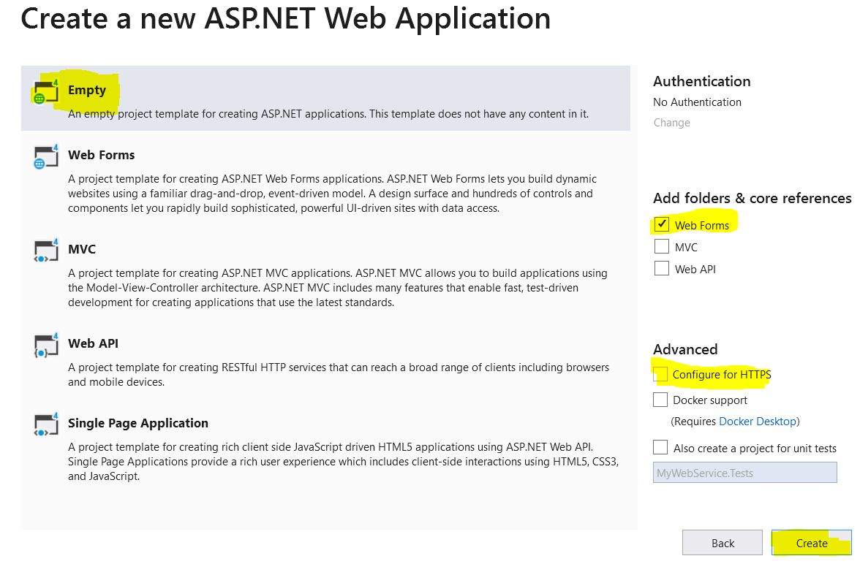
Demo Create a Webservice
Step 01 : Create a Web Application named MyWebService :
File | New Project | ASP.NET Web Application (.NET Framework)

Slide 21
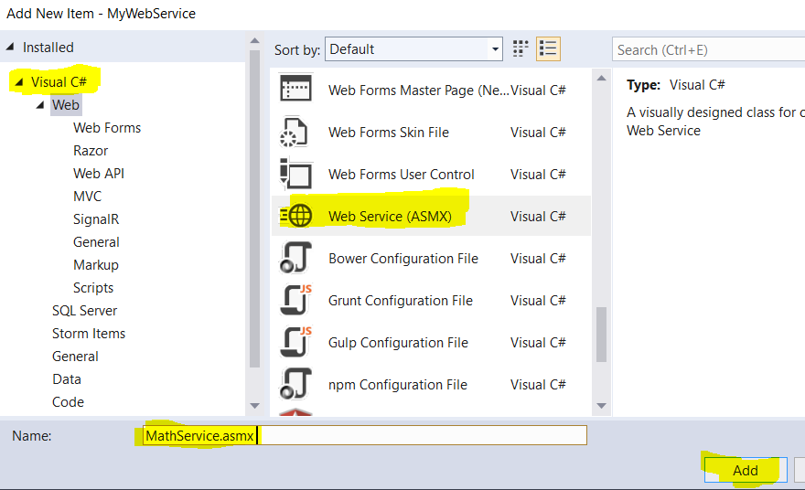
Demo Create a Webservice
Step 02 : Right-click on MyWebService project | Add | New Item

Slide 22
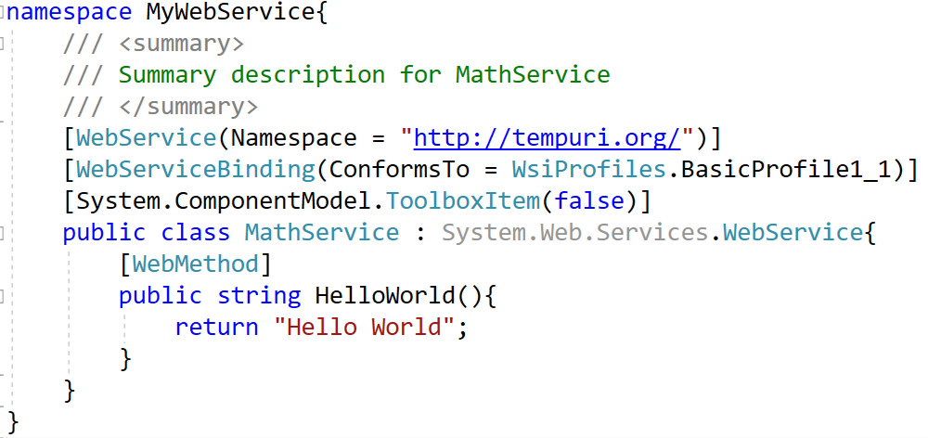
Demo Create a Webservice

Slide 23
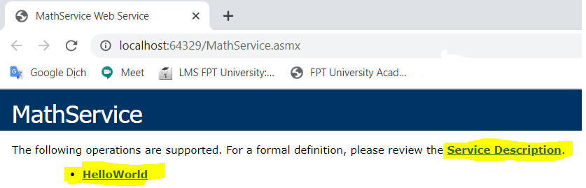
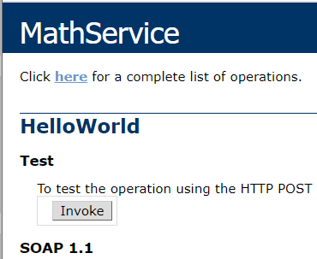
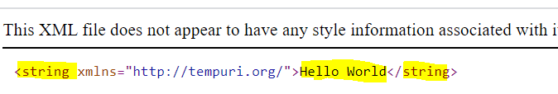
Demo Create a Webservice
Step 03 : Run WebService ( the same WebForm)
Right-click on MathService.asmx | View In Browser
Click on HelloWorld | Invoke and view result in XML format

Slide 24
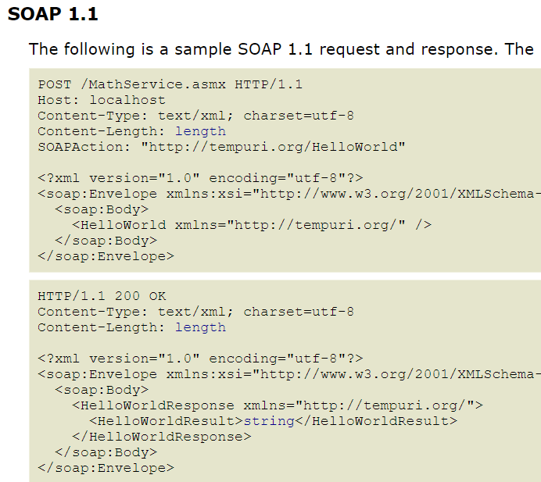
View SOAP message of Webservice

Slide 25
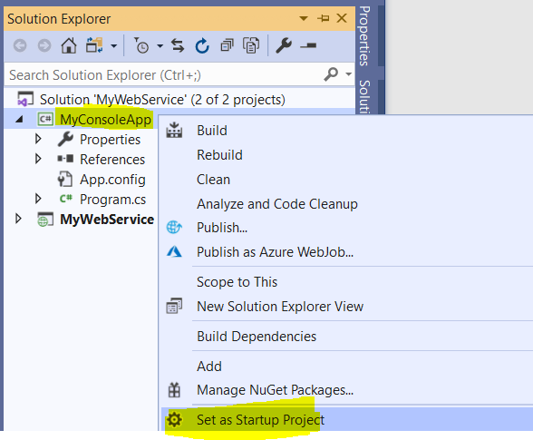
Demo Create a Webservice
Step 04 : Create Client Application ( use Console App in this demo ) named MyConsoleApp and Set as Startup Project for this project

Slide 26
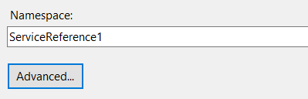
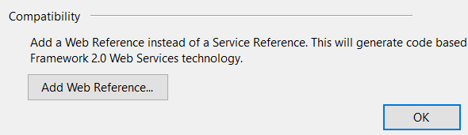

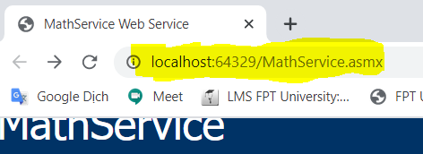
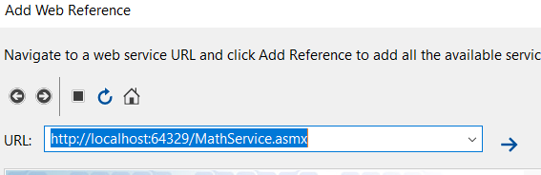
Demo Create a Webservice
Step 05 : Add WebReference to MyWebService from MyConsoleApp
-Right click on MyConsole | Add | Service Reference | Advanced | Add Web Reference | OK
-Copy URL of MathService.asmx in Step 03 and paste URL to the Add Web Reference dialog then click
1
2

Slide 27
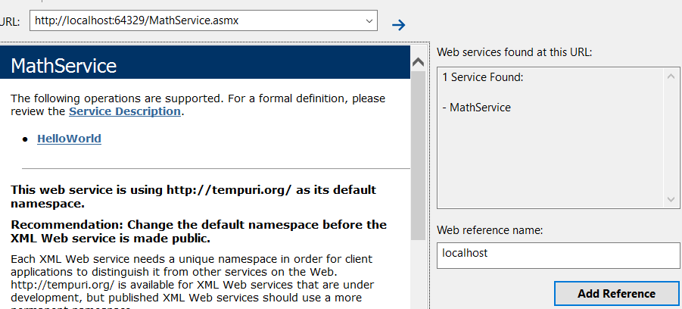
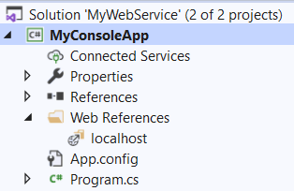
Demo Create a Webservice
Next -> Click Add Reference to complete
and then Buid project .

Slide 28
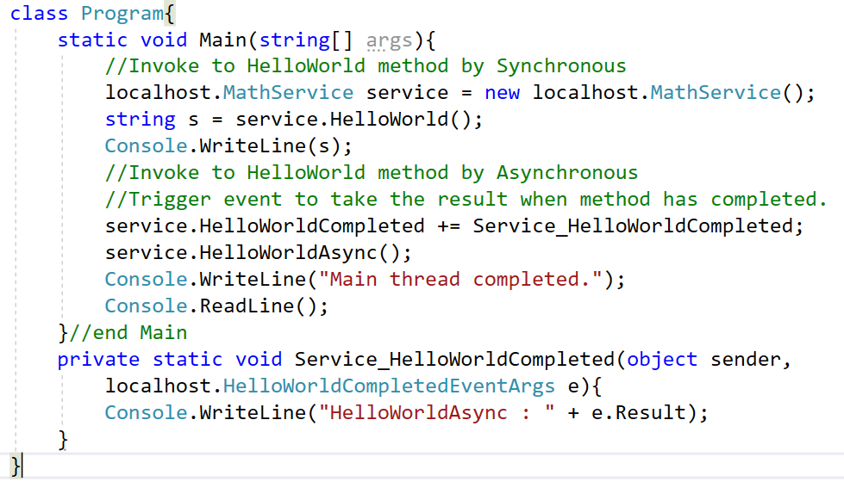
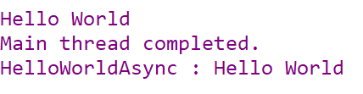
Demo Create a Webservice
Step 06 : Write code for Program.cs and then Run project

Slide 29
The Role of the WebService Base Class
A web service can derive directly from System.Object.
By default, web services developed using Visual Studio 2005 automatically derive from the System.Web.Service.WebService base class.
Key Members of the System.Web.Services.WebService Type
Property | Description
Application | Provides access to the HttpApplicationState object for the current HTTP request
Context | Provides access to the HttpContext type that encapsulates all HTTP-specific context used by the HTTP server to process web requests
Server | Provides access to the HttpServerUtility object for the current request
Session | Provides access to the HttpSessionState type for the current request
SoapVersion | Retrieves the version of the SOAP protocol used to make the SOAP request to the XML web service

Slide 30
The Role of the WebService Base Class
if you wish to build a stateful web service using Application and Session variables, you are required to derive from WebService.
if you are building an XML web service that does not require the ability to “remember” information about the external users, extending WebService is not required.

Slide 31
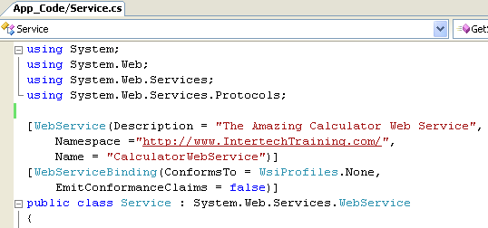
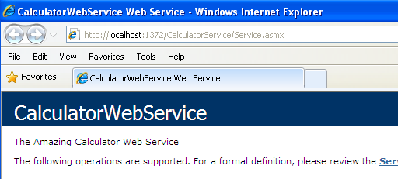
The [WebService] Attribute
The Name Property
Used to establish the name of the XML web service exposed to the outside world.
By default, the external name of a web service is identical to the name of the class type itself (Service by default).

Slide 32
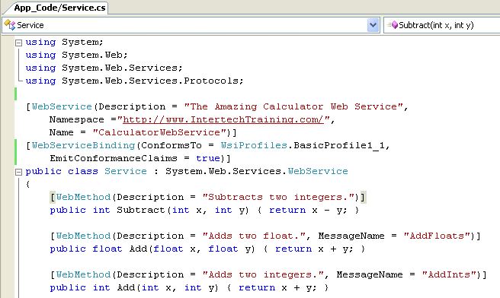
[WebServiceBinding] Attribute
Used to specify if the XML web service conforms to “Web services interoperability (WSI) basic profile 1.1”.
By default, XML web services generated using Visual Studio 2005 are assumed to conform to the WSI basic profile 1.1.
For example: overloading methods are not allowed in WSI basic profile 1.1
(http://www.ws-i.org/Profiles/BasicProfile-1.1.html)

Slide 33
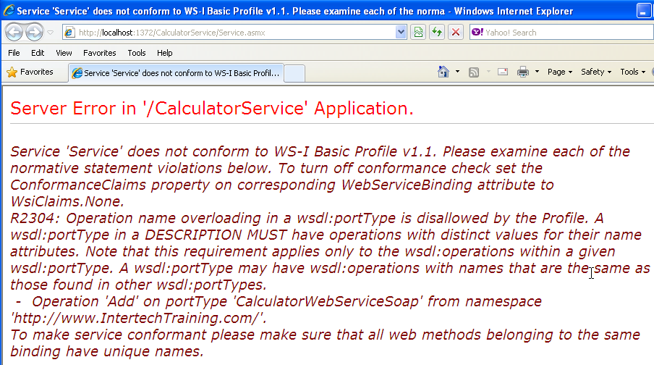

Slide 34
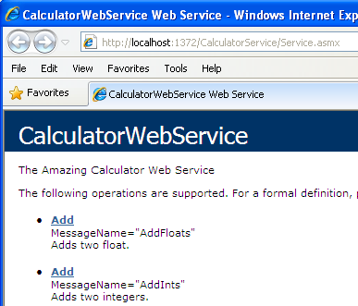
Ignoring BP 1.1 Conformance Verification

Slide 35
Disabling BP 1.1 Conformance Verification in web.config
<configuration>
<system.web>
<webServices>
<conformanceWarnings>
<remove name='BasicProfile1_1'/>
</conformanceWarnings>
</webServices>
</system.web>
</configuration>

Slide 36
The [WebMethod] Attribute
The [WebMethod] attribute must be applied to each method you wish to expose from an XML web service

Slide 37
The [WebMethod] Attribute
Avoiding WSDL Name Clashes via the MessageName Property

Slide 38
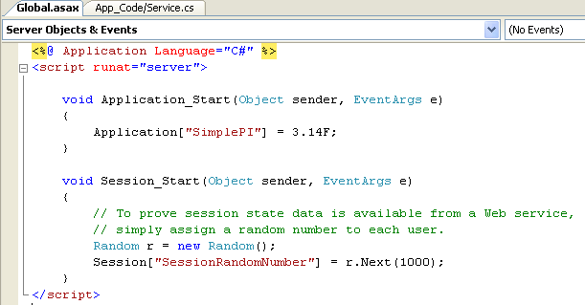
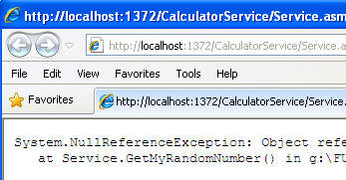
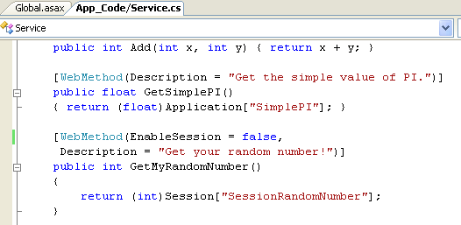
Stateful Web Services via the EnableSession Property
Global.asax
This must be set as true if we want to access session variable
By default each web method has
session state disabled

Slide 39
Full example: Ch_25 Code\CalculatorService

Slide 40
Web Service Description Language(WSDL)
WSDL is used to describe the following characteristics for each exposed web method:
The name of the XML web methods
The number of, type of, and ordering of parameters (if any)
The type of return value (if any)
The HTTP GET, HTTP POST, and SOAP calling conventions
In most cases, WSDL documents are generated automatically by web server.
http://localhost/SomeWS/theWS.asmx?wsdl
For more information: http://www.w3.org/tr/wsdl .

Slide 41
<?xml version="1.0" encoding="utf-8"?>
<wsdl:definitions ...>
<wsdl:types>
<!-- List of types exposed from WS ->
<wsdl:/types>
<wsdl:message>
<!-- Format of the messages ->
<wsdl:/message>
<wsdl:portType>
<!-- Port information ->
<wsdl:/portType>
<wsdl:binding>
<!-- Binding information ->
<wsdl:/binding>
<wsdl:service>
<!-- Information about the XML web service itself ->
<wsdl:/service>
< wsdl:/definitions>

Slide 42
Web Service Description Language(WSDL)
The <types> Element
Contains descriptions of any and all data types exposed from the web service.
XML itself defines a number of “core” data types (http://www.w3.org/2001/XMLSchema).

Slide 43
Web Service Description Language(WSDL)
Example: The Subtract() method of CalculatorService. the CLR System.Int32 is described within a <complexType> element:
The integer that is returned from the Subtract() method:
<s:element name="Subtract">
<s:complexType>
<s:sequence>
<s:element minOccurs="1" maxOccurs="1" name="x" type="s:int" />
<s:element minOccurs="1" maxOccurs="1" name="y" type="s:int" />
</s:sequence>
</s:complexType>
</s:element>
<s:element name="SubtractResponse">
<s:complexType>
<s:sequence>
<s:element minOccurs="1" maxOccurs="1" name="SubtractResult" type="s:int" />
</s:sequence>
</s:complexType>
</s:element>

Slide 44
Web Service Description Language(WSDL)
Custom data types:
public struct Point
{
public int x;
public int y;
public string pointName;
}
<s:complexType name="Point">
<s:sequence>
<s:element minOccurs="1" maxOccurs="1" name="x" type="s:int" />
<s:element minOccurs="1" maxOccurs="1" name="y" type="s:int" />
<s:element minOccurs="0" maxOccurs="1" name="pointName" type="s:string" />
</s:sequence>
</s:complexType>

Slide 45
Web Service Description Language(WSDL)
The <message> Element
Used to define the format of the request and response exchange for a given web method.
It is permissible for a single WSDL document to define multiple <message> elements which are transmitted between the sender and receiver,
<message> tend to occur in pairs.
<wsdl:message name="SubtractSoapIn">
<wsdl:part name="parameters" element="tns:Subtract" />
</wsdl:message>
<wsdl:message name="SubtractSoapOut">
<wsdl:part name="parameters" element="tns:SubtractResponse" />
</wsdl:message>

Slide 46
Web Service Description Language(WSDL)
To HTTP POST bindings, the generated WSDL show the following <message> data:
If a web method is a one-way method, then it only is necessary a request <message> element of which method can be marked by applying the [SoapDocumentMethod] attribute.
<wsdl:message name="SubtractHttpPostIn">
<part name="n1" type="s:string" />
<part name="n2" type="s:string" />
<wsdl:/message>
<wsdl:message name="SubtractHttpPostOut">
<part name="Body" element="s0:int" />
<wsdl:/message>

Slide 47
Web Service Description Language(WSDL)
The <portType> Element
Defines the characteristics of the various correspondences that can occur between the client and server, each of which is represented by an <operation> subelement.
EX: The one-way operation, the solicit/response operation.
<wsdl:portType name="CalculatorWebServiceSoap">
<wsdl:operation name="Subtract">
<wsdl:input message="tns:SubtractSoapIn" />
<wsdl:output message="tns:SubtractSoapOut" />
</wsdl:operation>
<wsdl:/portType>

Slide 48
Web Service Description Language(WSDL)
The <binding> Element
Specifies the exact format of the HTTP GET, HTTP POST, and SOAP exchanges.
<wsdl:binding name="CalculatorWebServiceSoap12"
type="tns:CalculatorWebServiceSoap">
<soap12:binding transport="http://schemas.xmlsoap.org/soap/http" />
<wsdl:operation name="Subtract">
<soap12:operation soapAction="http://www.IntertechTraining.com/Subtract"
style="document" />
<wsdl:input>
<soap12:body use="literal" />
</wsdl:input>
<wsdl:output>
<soap12:body use="literal" />
</wsdl:output>
</wsdl:operation>
</wsdl:binding>

Slide 49
Web Service Description Language(WSDL)
The <service> Element
Specifies the characteristics of the web service itself (such as its URL).
The chief duty of this element is to describe the set of ports exposed from a given web server.
The <services> element makes use of any number of <port> subelements.

Slide 50
Web Service Description Language(WSDL)
The <service> Element
<wsdl:service name="CalculatorWebService">
<wsdl:documentation xmlns:wsdl="http://schemas.xmlsoap.org/wsdl/">
The Amazing Calculator Web Service
</wsdl:documentation>
<wsdl:port name="CalculatorWebServiceSoap"
binding="tns:CalculatorWebServiceSoap">
<soap:address location= "http://localhost:1109/CalculatorService/Service.asmx" />
</wsdl:port>
<wsdl:port name="CalculatorWebServiceSoap12"
binding="tns:CalculatorWebServiceSoap12">
<soap12:address location= "http://localhost:1109/CalculatorService/Service.asmx" />
</wsdl:port>
</wsdl:service>

Slide 51
XML Web Service Wire Protocol
XML web services can use any RPC protocol to facilitate communication (such as DCOM or CORBA).
However, most web servers bundle this data into the body of an HTTP request and transmits it to the consumer using one of three core bindings:
Transmission Binding | Description
HTTP GET | GET submissions append parameters to the query string of the URL.
HTTP POST | POST transmissions embed the data points into the header of the HTTP message rather than appending them to the query string.
SOAP | SOAP is a wire protocol that specifies how to submit data and invoke methods across the wire using XML.
Notes:
Microsoft Remote Procedure Call (RPC) is an interprocess communication (IPC) mechanism that enables data exchange and invocation of functionality residing in a different process. That process can be on the same computer, on the local area network (LAN), or across the Internet. The Microsoft RPC mechanism uses other IPC mechanisms, such as named pipes, NetBIOS, or Winsock, to establish communications between the client and the server. With RPC, essential program logic and related procedure code can exist on different computers, which is important for distributed applications.
(http://technet.microsoft.com/en-us/library/cc738291(WS.10).aspx)

Slide 52
XML Web Service Wire Protocol
HTTP GET and HTTP POST Bindings
Not rich enough to represent such complex items as structures or classes.
Supported POST and GET Data Types
Data Types | Description
Enumerations | GET and POST verbs support the transmission of .NET System.Enum types
Simple arrays | You can construct arrays of any primitive type.
Strings | GET and POST transmit all numerical data as a string token.

Slide 53
XML Web Service Wire Protocol
SOAP Bindings
SOAP itself does not define a specific protocol and can thus be used with any number of existing Internet protocols (HTTP, SMTP, and others).
Provide a mechanism to invoke methods using complex types in a language- and platform-neutral manner.
A SOAP message defines two core sections:
SOAP envelope: understood as the conceptual container for the relevant information.
SOAP body: contains rules that are used to describe the information in said message.
An optional third section (the SOAP header) may be used to specify general information regarding the message itself, such as security or transactional information.

Slide 54
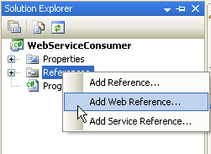
Building Client application
Create a console application consuming web service
(Ch_25 Code\CalculatorService)

Slide 55
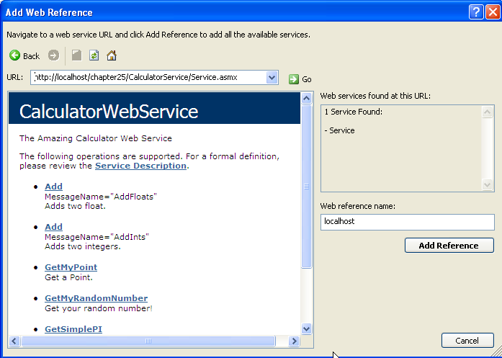
1. Input the url of your web service and click “Go”
2. Change this name if you wish
3. Finally

Slide 56
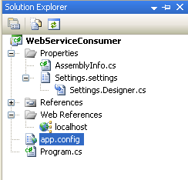
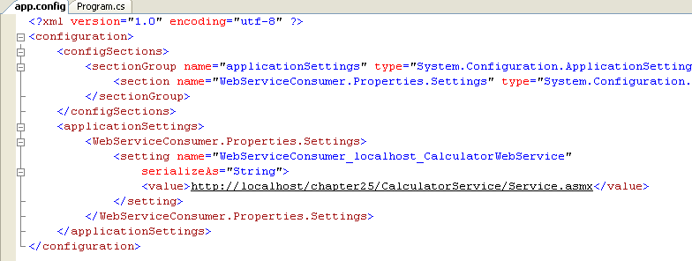
If the url location of the web service changed, we just need to modify this value

Slide 57
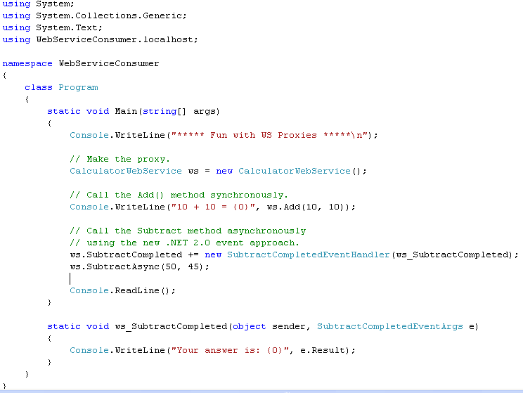
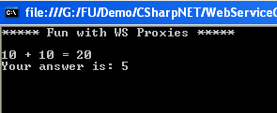
Synchronous call
Asynchronous call

Slide 58
More example:
Ch_25 Code\CarSalesInfoWS,
Ch_25 Code\CarsSalesInfoClient

Slide 59
Summary
XML Web Services introduction
Web Service components: Discovery, Description, Transport protocol
Understanding the [WebService] Attribute
Understanding the [WebServiceBinding] Attribute
Understanding the [WebMethod] Attribute
XML Web Service Wire Protocols: HTTP GET, HTTP POST, SOAP

Slide 60
Chapter 25: Q & A

